Slide 1
How to Manage Electronic Resources in a Network Zone Consortia Using Inventory Network Groups
Yoel Kortick
Senior Librarian

Slide 2

Agenda
The Network Zone Consortia Environment
Defining the Inventory Network Groups
Attributing groups to a resource – the examples
The effects of the inventory network group in Primo
The effects of the inventory network group on the OpenURL
Repository search
Alma Analytics and Inventory Network Groups
Inventory Network Groups for libraries and campuses

Slide 3
The Network Zone Consortia Environment

Slide 4
The Network Zone Consortia Environment
This presentation relates specifically to managing electronic resources in the Network Zone Consortia Environment.
In such an environment there is a Network Zone as well as multiple Member Institutions.
In this specific presentation the electronic resources, whether they be an entire electronic collection or one specific portfolio, are managed in the Network Zone.
We will focus here on managing the availability of the resources in the Member Institutions. This presentation will not deal with acquisitions-related issues.

Slide 5
The Network Zone Consortia Environment
In the example here we have a network zone and three member institutions:
Member / Network | Name | Inst. Code
Network | Ex Libris University Consortium | EXLDEMO2_INST
Member | Alma University | EXLDEV1_INST
Member | Open University | EXLDEMO3_INST
Member | University of Knowledge | EXLDEMO1_INST

Slide 6

The Network Zone Consortia Environment
Network Zone
Ex Libris University Consortium
Member Institution
Alma University
Member Institution
Open University
Member Institution
University of Knowledge

Slide 7
Defining the Inventory Network Groups

Slide 8
Defining the Inventory Network Groups
In this flow the access to the resources is controlled via the "available for" group settings in the Network Zone.
Alma makes use of the "inventory network groups" defined in the "resources" configuration menu.
This is commonly referred to as Distributed Access to Electronic Resources from the Network Zone

Slide 9
Defining the Inventory Network Groups
When using the "inventory network groups" it is possible to define a group which would be any of the following
  All of the institutions
  Specific groups of institutions
  Each specific institution (Note that it is also possible to define a group based on a library or campus of an institution rather than the entire institution, but more about that later).
One or more groups could then be associated with a specific electronic resource (portfolio or entire electronic collection)

Slide 10
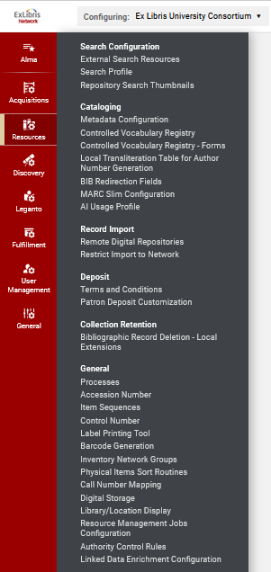
Defining the Inventory Network Groups
The inventory network groups are accessed via configuration menu > resources > general > inventory network groups
We are in the Network Zone

Slide 11
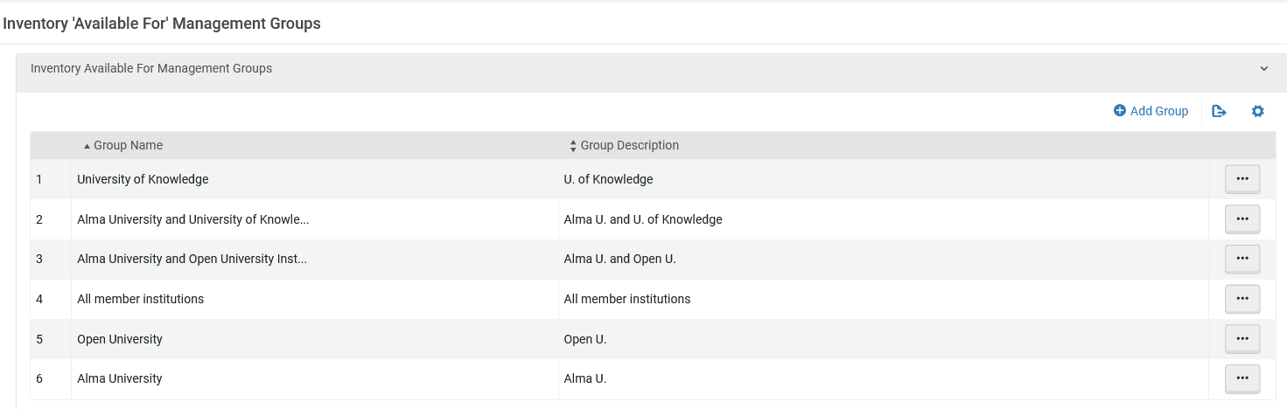
Defining the Inventory Network Groups
Here we have several different groups. One is for all institutions. Others are for one institution or a combination thereof.
Single specific institutions
Two specific institutions
All institutions

Slide 12
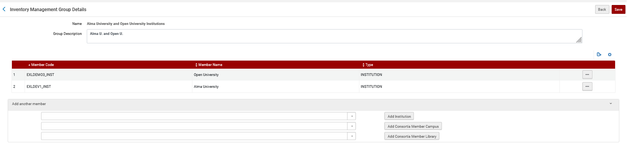
Defining the Inventory Network Groups
Here for example, we have two specific institutions belonging to inventory network group named "Alma University and Open University Institutions"
Two specific institutions

Slide 13
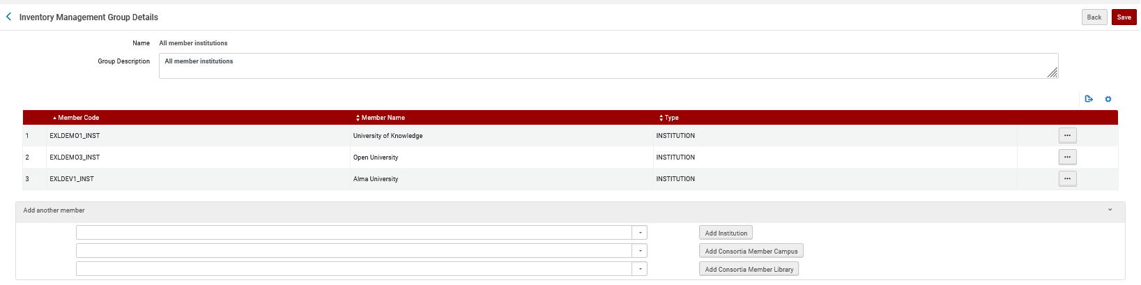
Defining the Inventory Network Groups
Here for example, we have all three member institutions belonging to inventory network group named "All member institutions"
All three member institutions

Slide 14
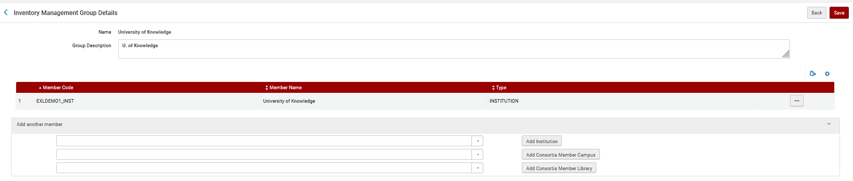
Defining the Inventory Network Groups
Here for example, we have one specific institution belonging to inventory network group named "University of Knowledge"
Single specific institution

Slide 15
Attributing groups to a resource – the examples

Slide 16
Attributing groups to a resource – the examples
Example one
  Electronic collection "British and Irish Women's Letters and Diaries: Second Edition"
  Activate from CZ then edit Group Settings of electronic collection editor
  Make it available for Alma University
Example two
  Electronic collection "Women and Social Movements: Development and the Global South, 1919-2019 (Video)" exists in network
  Edit Group Settings of electronic collection editor
  Make it available for Alma University and Open University and University of Knowledge (All member institutions)
Example three
  Electronic portfolio "Feminist Phenomenology" exists in network
  Edit Group Settings of electronic portfolio editor
  Make it available for Alma University and Open University
Example four
  Electronic portfolio "Companion to Environmental Studies"
  Activate from CZ then do not do anything to the group settings

Slide 17
Attributing groups to a resource – the examples
Note that our examples here include both electronic collections as well as portfolios.
If the portfolio is part of an electronic collection, then it will inherit the inventory management groups from the electronic collection.
If the portfolio is part of an electronic collection and it is given a specific inventory management group, then the specific inventory management group will override the inherited values of the collection.

Slide 18
Example 1

Slide 19
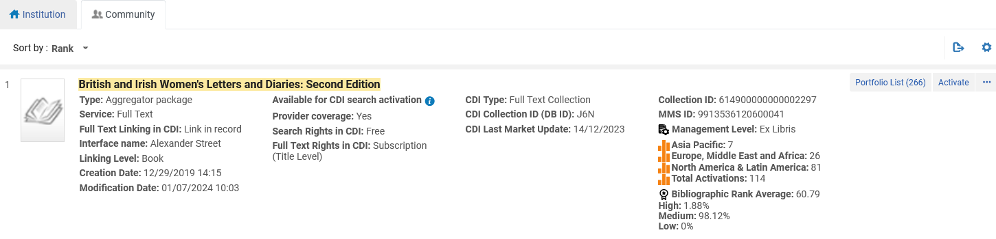
Attributing groups to a resource – Example 1
From the Network Zone institution, we search the Community Zone for electronic collection "British and Irish Women's Letters and Diaries: Second Edition".
We then activate the collection.

Slide 20
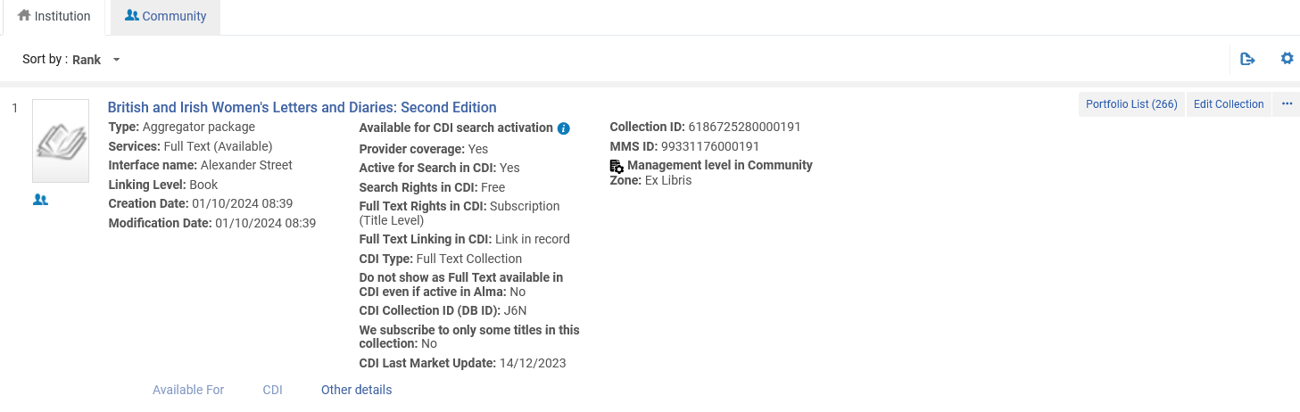
Attributing groups to a resource – Example 1
The electronic collection is now activated in the Network Zone and from the Network Zone "institution" tab we edit the collection

Slide 21
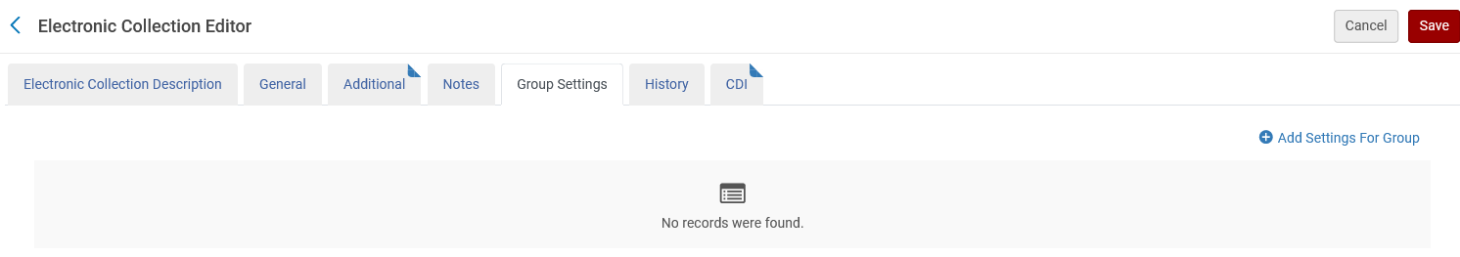
Attributing groups to a resource – Example 1
Now we will edit the group settings and add a setting

Slide 22
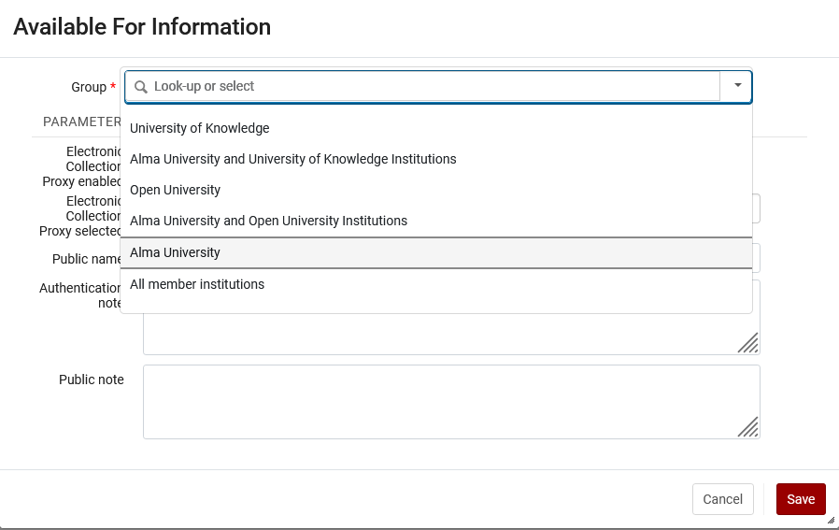
Attributing groups to a resource – Example 1
We will choose to make it available for Alma University

Slide 23
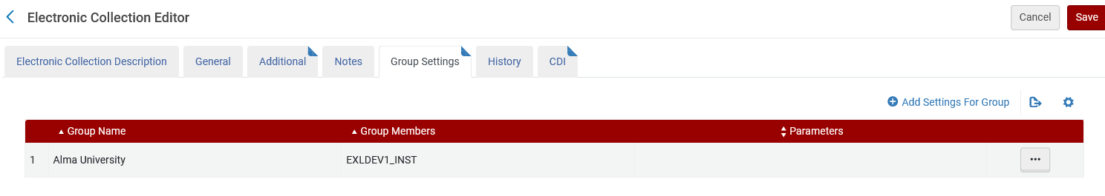
Attributing groups to a resource – Example 1
Now it is available for Alma University

Slide 24
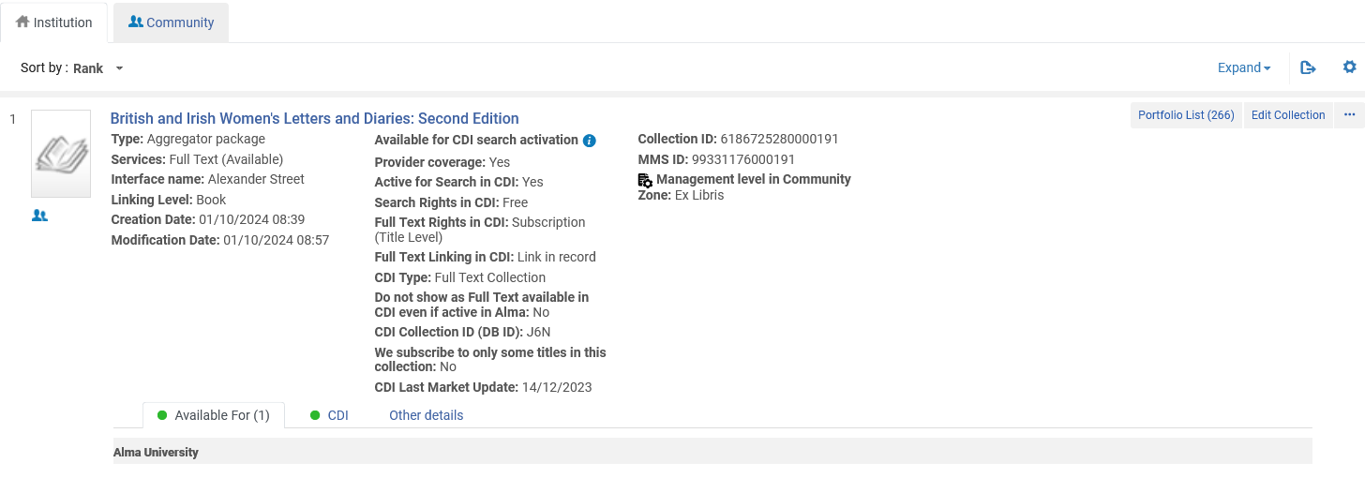
Attributing groups to a resource – Example 1
Now it is available for Alma University (as seen in repository search in the institution tab of the Network Zone institution)

Slide 25
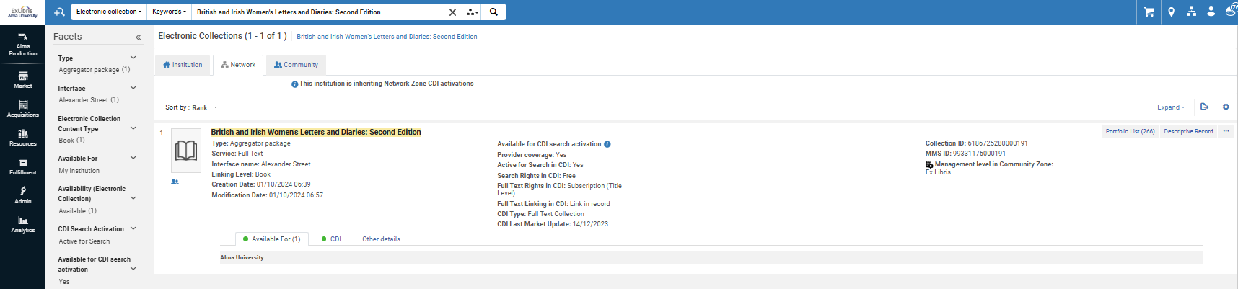
Attributing groups to a resource – Example 1
This is repository search for electronic collections while logged into member institution Alma University and searching the network zone

Slide 26
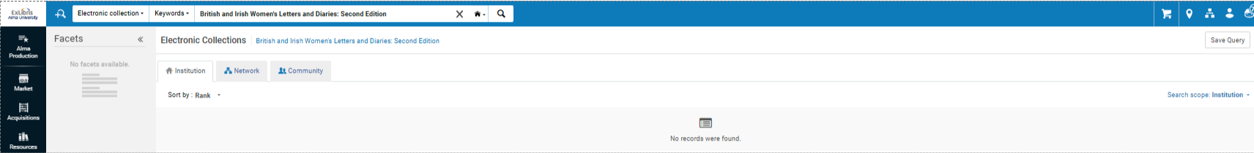
Attributing groups to a resource – Example 1
If we search Alma University Institution Tab with search scope "Institution" we will not find it
In one of the member institutions (in this case “Alma University”)

Slide 27
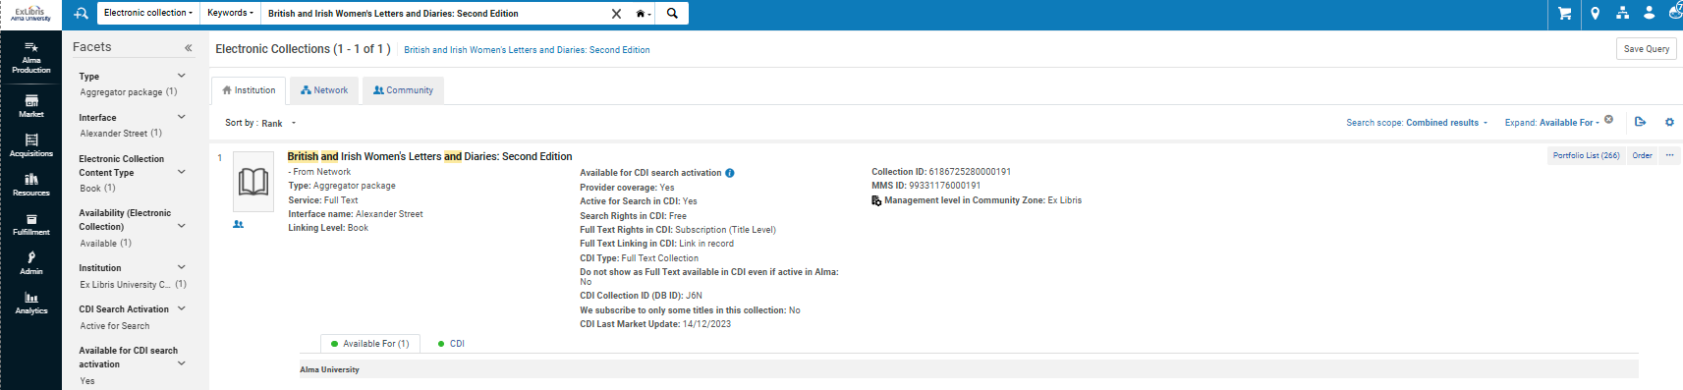
Attributing groups to a resource – Example 1
But … we will change the search scope to "Combined results", and we find it
Indication that it is from the network
Changed the Search scope to "Combined results"

Slide 28
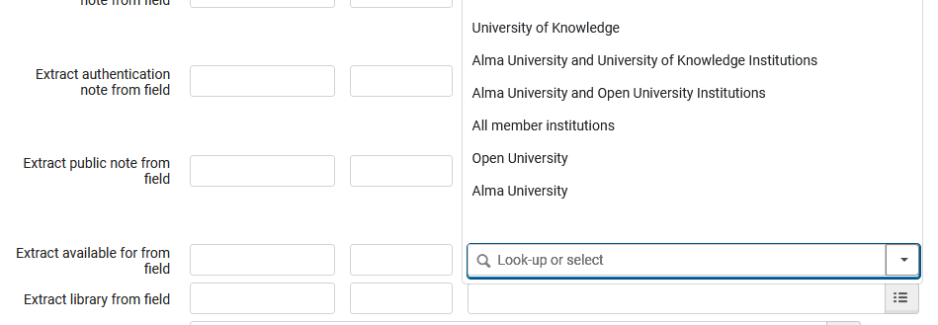
Attributing groups to a resource – Example 1
Note that in our example we manually added the "Available for" values. If the records were imported via an import profile this could be done automatically.
This screenshot is from an import profile of type "Repository" in the "Inventory Information" tab when "Portfolio Type" does not equal "Part of an electronic Collection"

Slide 29
Example 2

Slide 30
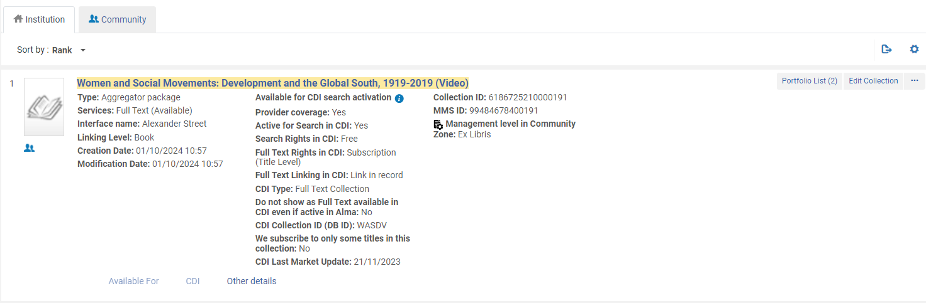
Attributing groups to a resource – Example 2
We are logged into the Network Zone and in the "institution" tab we see that the collection "Women and Social Movements: Development and the Global South, 1919-2019 (Video)" already exists in the Network Zone.
Electronic Collection is managed in the CZ
Edit the collection

Slide 31
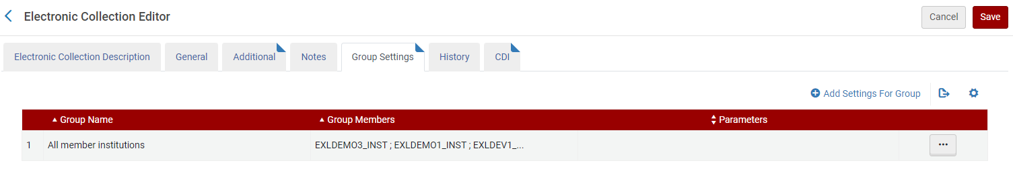
Attributing groups to a resource – Example 2
While in the electronic collection editor we switch to the "group settings" tab and add the group "All member institutions" (includes all three institutions)

Slide 32
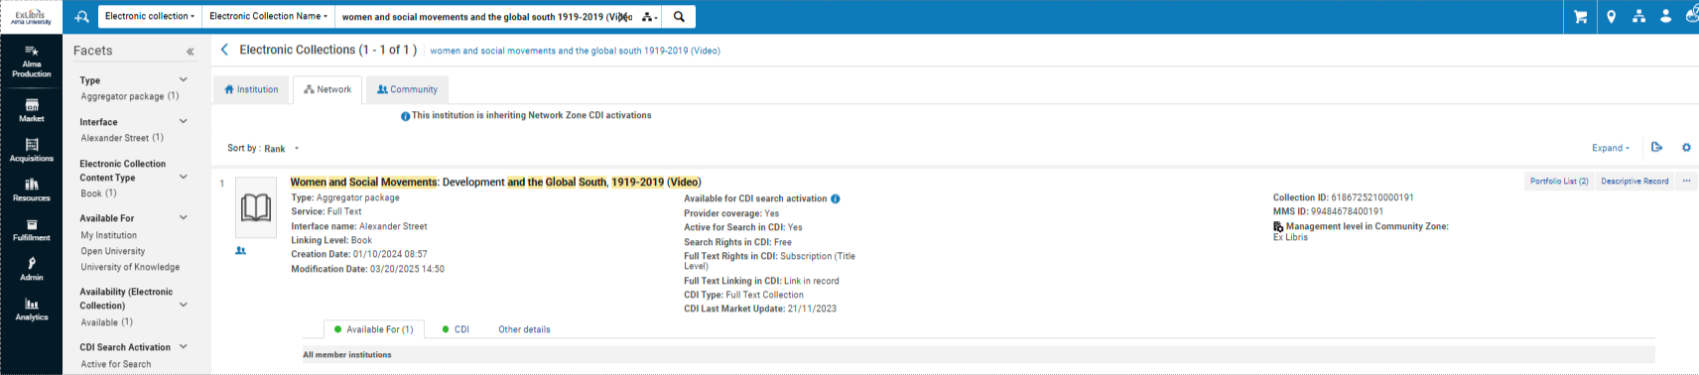
Attributing groups to a resource – Example 2
This is repository search for electronic collections while logged into one of the member institutions and searching the network tab
In one of the member institutions

Slide 33
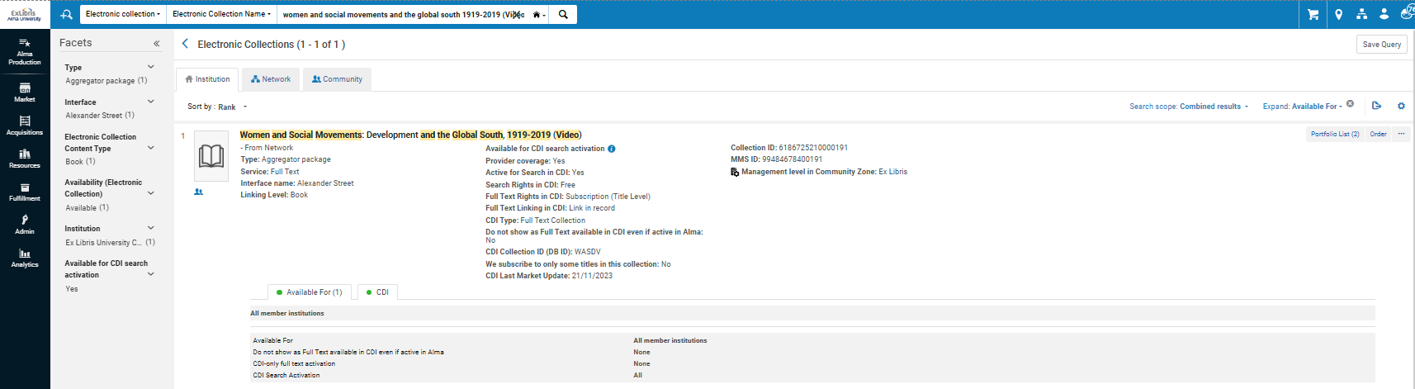
Attributing groups to a resource – Example 2
This is electronic collection repository search logged into one of the member institutions, searching the institution tab with search scope "combined results"
In one of the member institutions (in this case “Alma University”)
Indication that it is from the network

Slide 34
Example 3

Slide 35
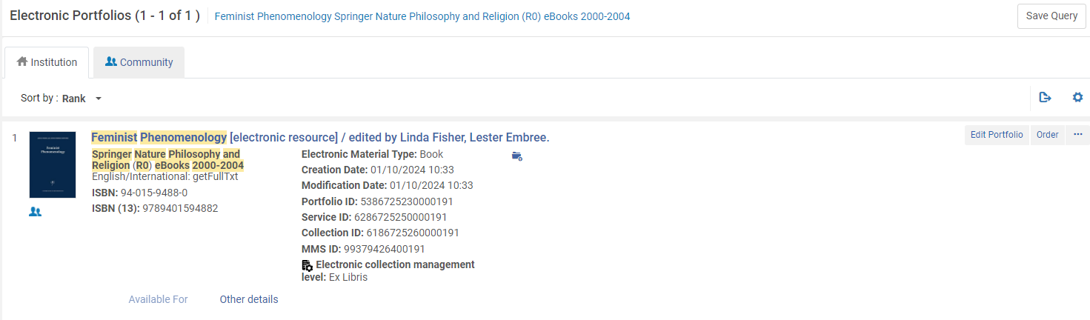
Attributing groups to a resource – Example 3
Here we are in the institution tab of the network zone and edit existing portfolio "Feminist Phenomenology" which is in collection "Springer Nature Philosophy and Religion (R0) eBooks 2000-2004".
Electronic Collection is managed in the CZ
Edit the portfolio

Slide 36
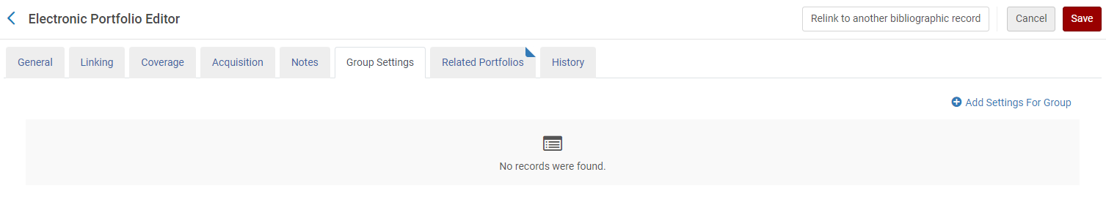
Attributing groups to a resource – Example 3
In the "Group Settings" tab we "Add Settings For Group"

Slide 37
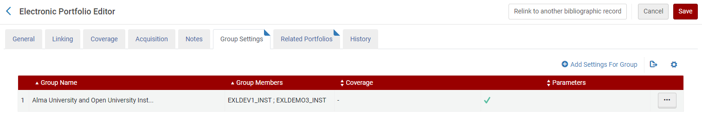
Attributing groups to a resource – Example 3
We added the group "Alma University and Open University Institutions" which includes institutions Alma University and Open University.

Slide 38
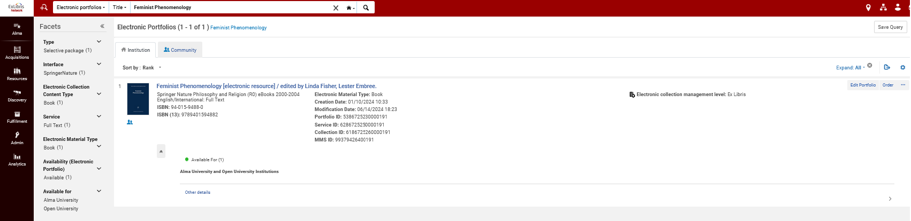
Attributing groups to a resource – Example 3
If we search the network zone institution for this portfolio via an "Electronic Portfolios" search we can see the "available for"

Slide 39
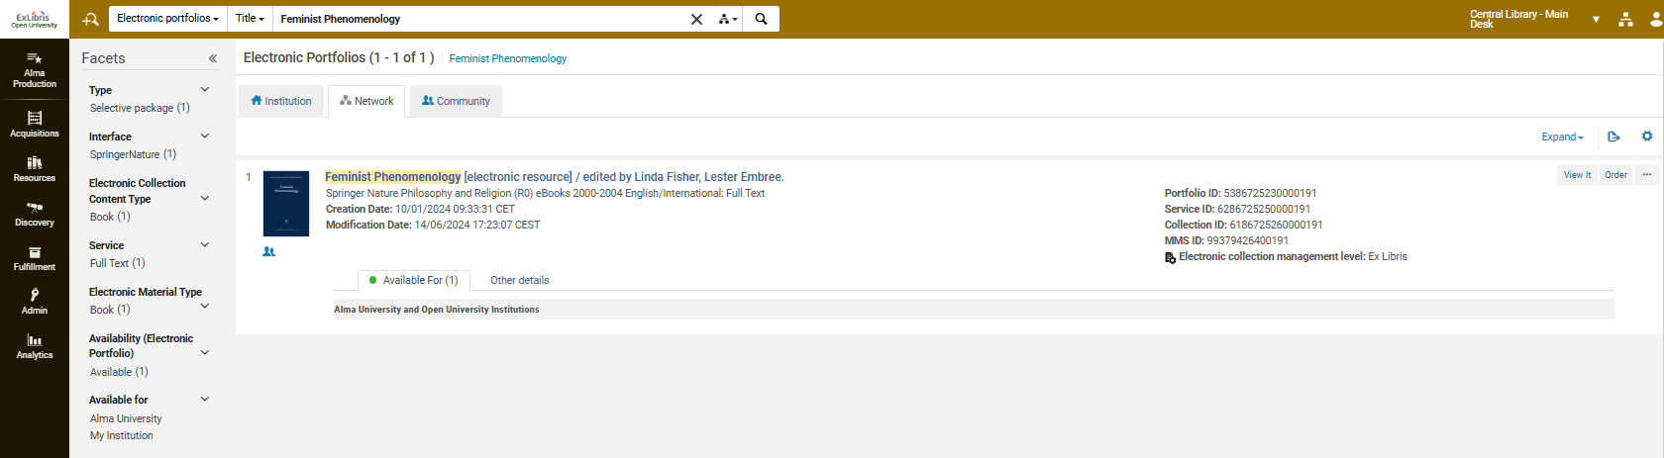
Attributing groups to a resource – Example 3
If we search the Network Zone tab in one of the member institutions, then we can see the "Available For"
In one of the member institutions (in this case “Open University”)

Slide 40
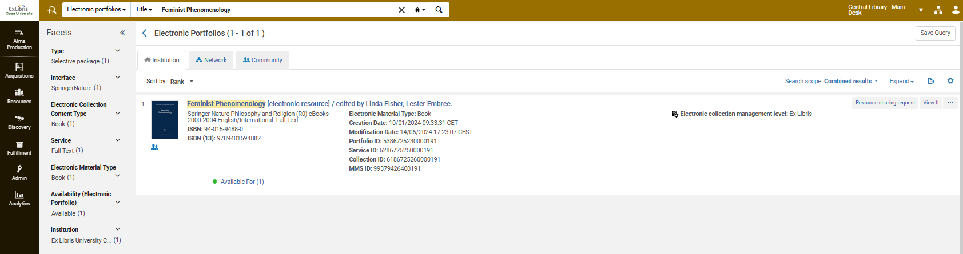
Attributing groups to a resource – Example 3
If we search the institution tab of Alma U or Open U (the institutions for whom it is available) with search scope "combined results" then we will find it.
Combined results
Open University

Slide 41
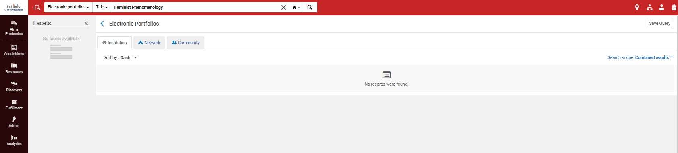
Attributing groups to a resource – Example 3
But in U of Knowledge, for whom it is not available, we do not find it in the institution tab with search scope "combined results".
U of Knowledge
Combined results

Slide 42
Example 4

Slide 43
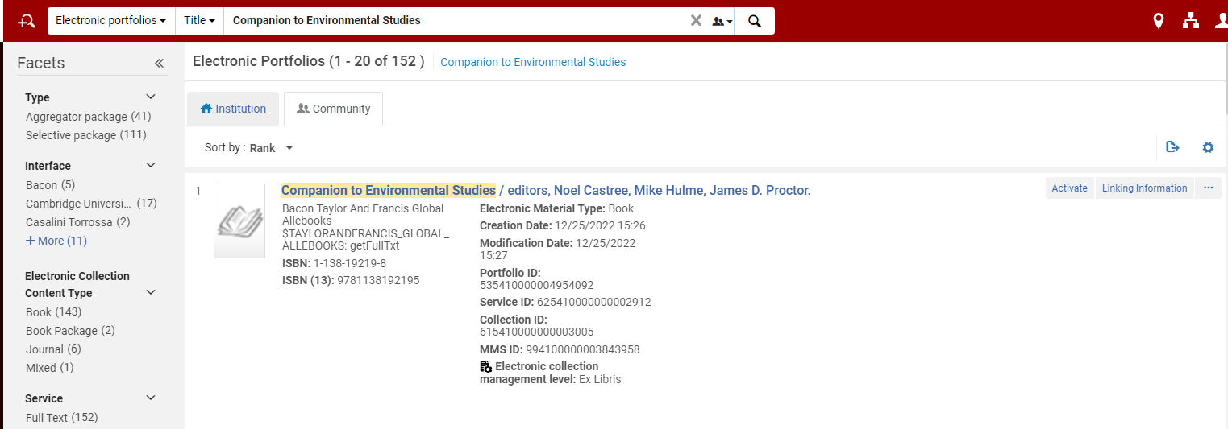
Attributing groups to a resource – Example 4
In the network institution we search the community zone for portfolio "Companion to Environmental Studies" and activate it

Slide 44
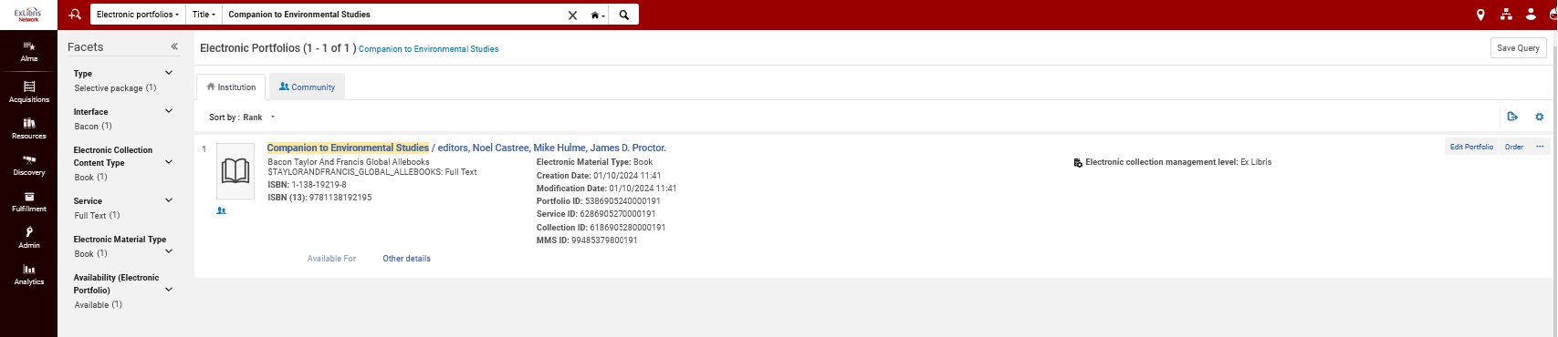
Attributing groups to a resource – Example 4
Portfolio "Companion to Environmental Studies" is now linked to the community zone. Here it is in the network zone institution.

Slide 45
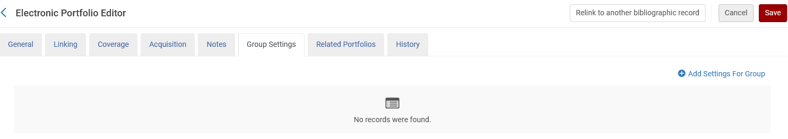
Attributing groups to a resource – Example 4
There are no group settings.

Slide 46
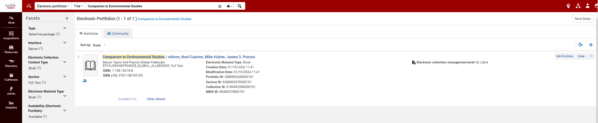
Attributing groups to a resource – Example 4
If we search the network zone institution for this portfolio via an "Electronic Portfolios" search we can see that the "available for" link is greyed out

Slide 47
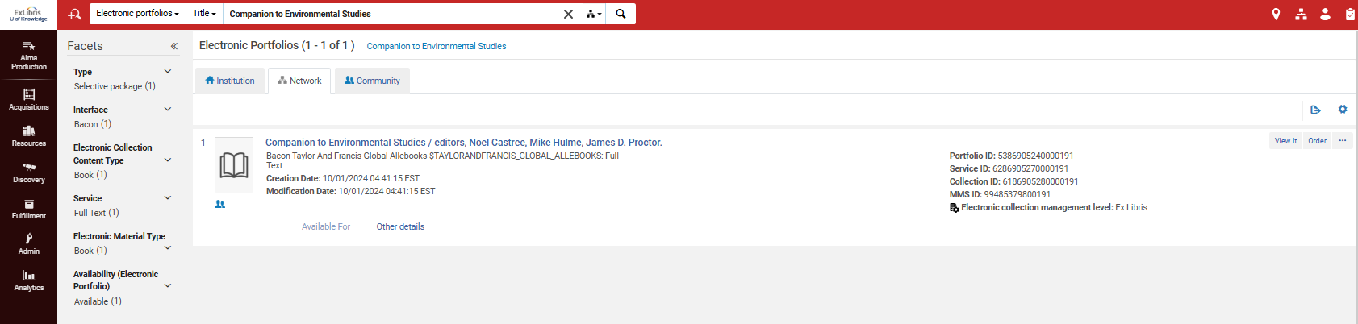
Attributing groups to a resource – Example 4
If we search the network zone tab in one of the member institutions, then we can also see that the "available for" link is greyed out
In one of the member institutions (in this case “U. of Knowledge”)

Slide 48
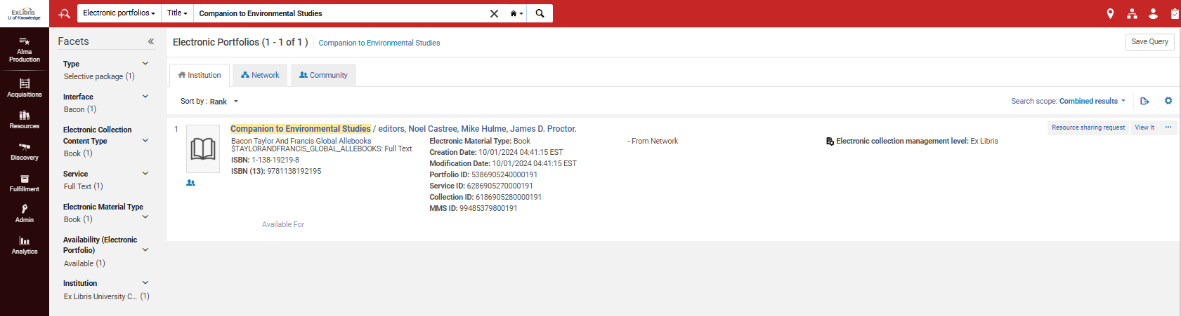
Attributing groups to a resource – Example 4
If we search the institution tab of any of the institutions using search scope "combined results" then we do find it.
In one of the member institutions (in this case “U. of Knowledge”)

Slide 49
Attributing groups to a resource – Example 4
When we do not put in an Inventory Network Group the resources is available for all institutions.
You may be asking yourself why, if putting no inventory network group means it is available for all institutions, is it necessary to use an inventory network group which includes all institutions?
In other words: what is the difference between
  example 2 in which we used an inventory network group containing all institutions
  example 4 where we used no inventory network group?
They are both available for all institutions.

Slide 50
Attributing groups to a resource – Example 4
Answer: It may be a matter of consortia policy to always use inventory network groups regardless of whether the resource is available for one, some, or all institutions.
Answer: There is a difference in the repository search results when using an inventory network group and not using an inventory network group. We will see more on this later in the section on repository search.

Slide 51
The effects of the inventory network group in Primo

Slide 52
The effects of the inventory network group in Primo
We will now look at the four examples in Primo
We will see that they do and do not appear in Primo exactly according to the "Available For" Inventory Network Groups which we defined for each resource.

Slide 53
The effects of the inventory network group in Primo
Example 1
Electronic collection "British and Irish Women's Letters and Diaries: Second Edition" is available only for Alma University.

Slide 54
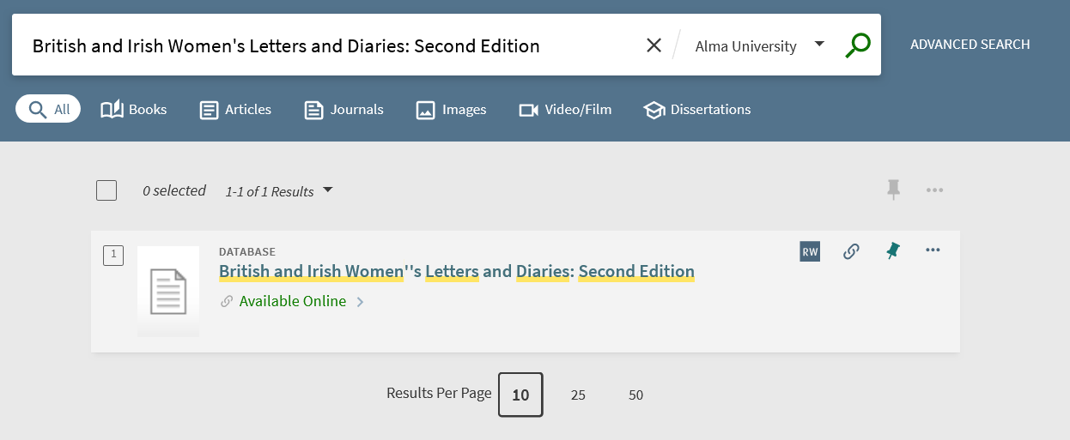
The effects of the inventory network group in Primo
Example 1
It does appear in Primo for Alma University.

Slide 55
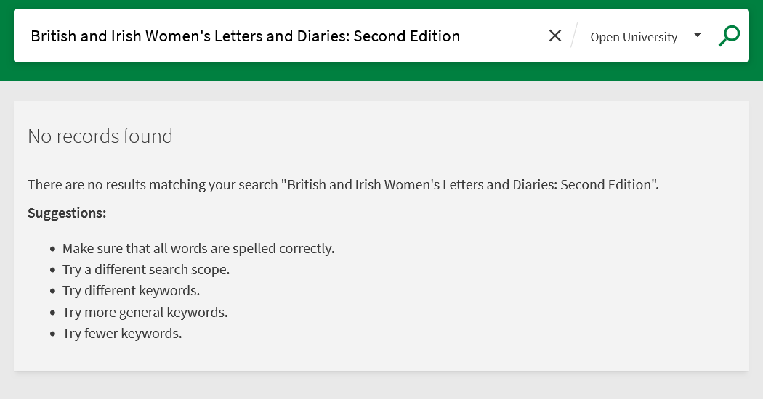
The effects of the inventory network group in Primo
Example 1
It does not appear in Primo for Open University.

Slide 56
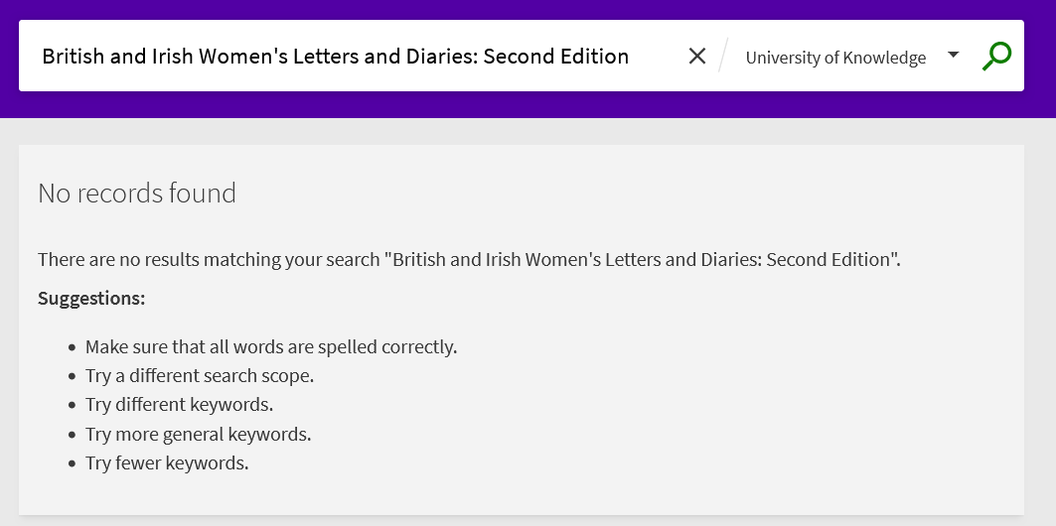
The effects of the inventory network group in Primo
Example 1
It does not appear in Primo for University of Knowledge.

Slide 57
The effects of the inventory network group in Primo
Example 2
Electronic collection "Women and Social Movements: Development and the Global South, 1919-2019 (Video)" is available for Alma University and Open University and University of Knowledge

Slide 58
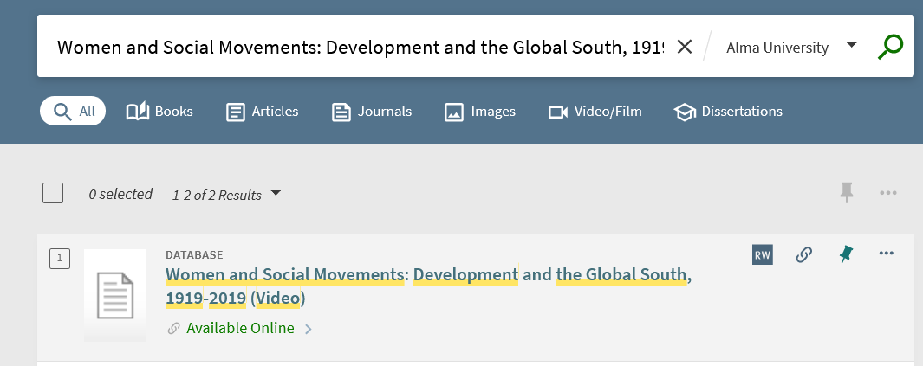
The effects of the inventory network group in Primo
Example 2
It does appear in Primo for Alma University.

Slide 59
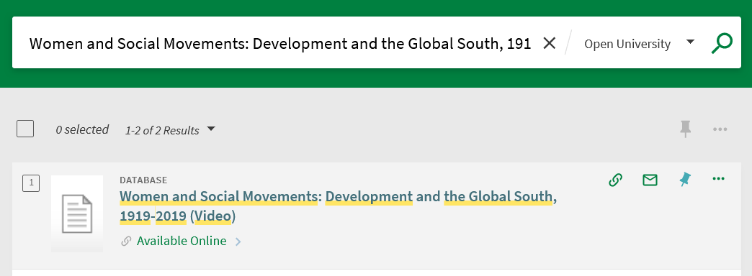
The effects of the inventory network group in Primo
Example 2
It does appear in Primo for Open University.

Slide 60
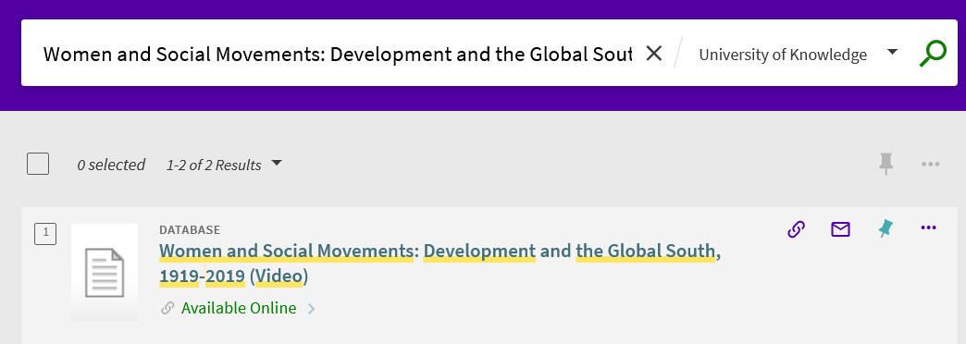
The effects of the inventory network group in Primo
Example 2
It does appear in Primo for University of Knowledge.

Slide 61
The effects of the inventory network group in Primo
Example 3
Electronic portfolio "Feminist Phenomenology" is available for Alma University and Open University

Slide 62
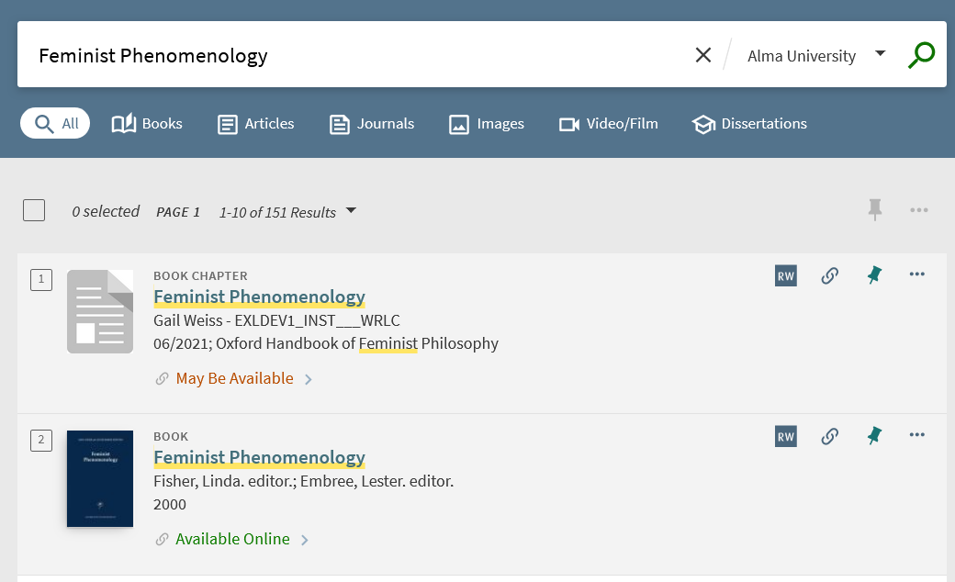
The effects of the inventory network group in Primo
Example 3
It does appear in Primo for Alma University.

Slide 63
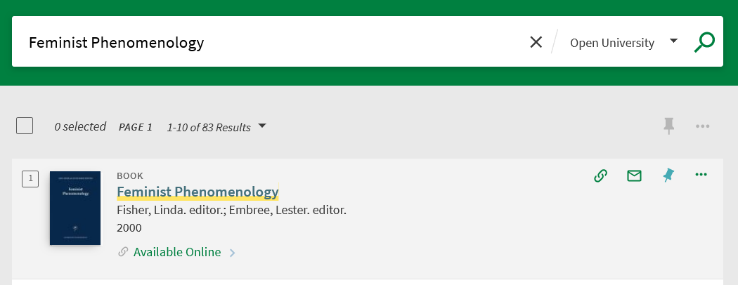
The effects of the inventory network group in Primo
Example 3
It does appear in Primo for Open University.

Slide 64
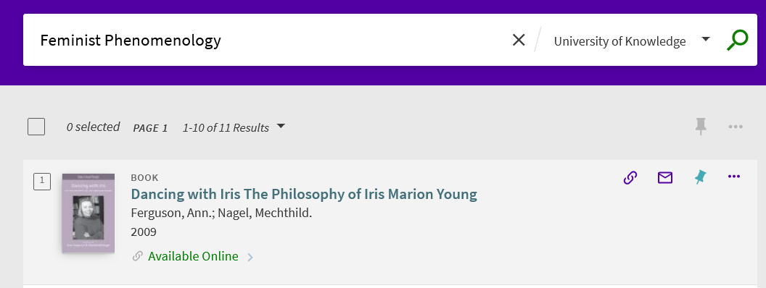
The effects of the inventory network group in Primo
Example 3
It does not appear in Primo for University of Knowledge.
These are other results which contain the string

Slide 65
The effects of the inventory network group in Primo
Example 4
Electronic portfolio "Companion to Environmental Studies" has no group settings and therefore is available for all institutions

Slide 66
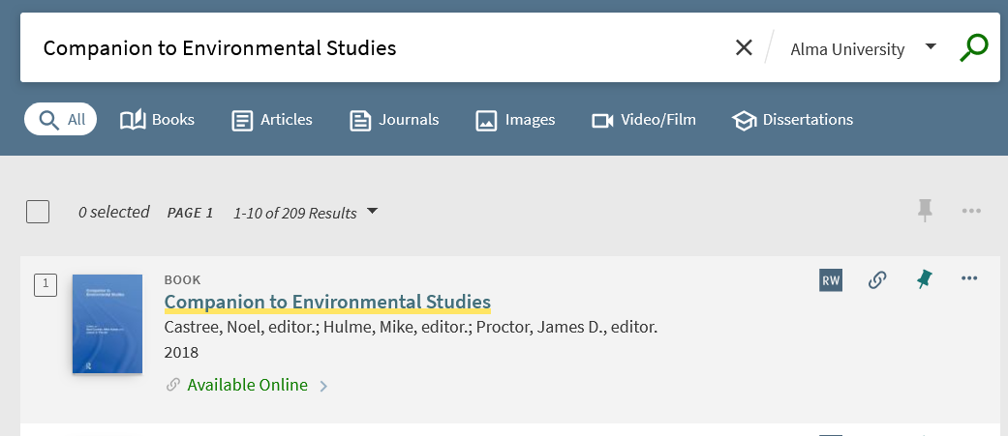
The effects of the inventory network group in Primo
Example 4
It does appear in Primo for Alma University.

Slide 67
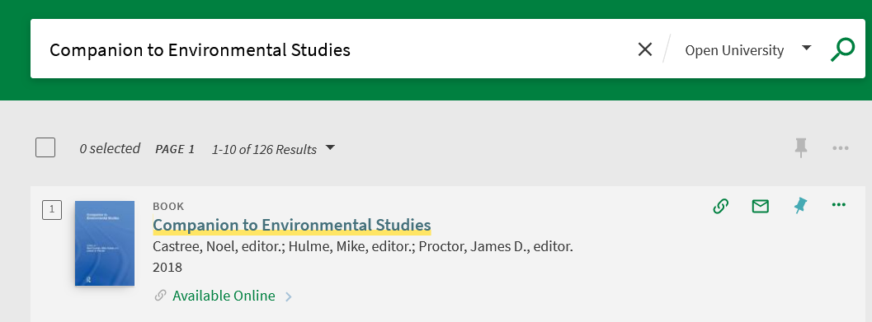
The effects of the inventory network group in Primo
Example 4
It does appear in Primo for Open University.

Slide 68
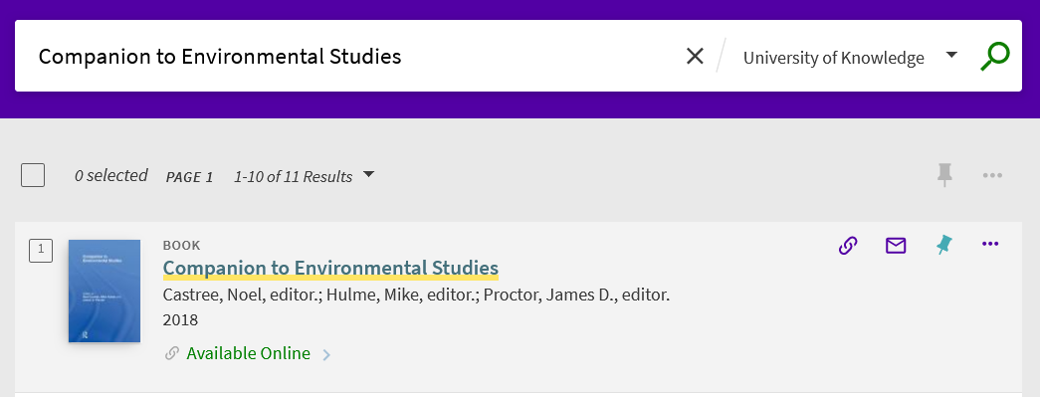
The effects of the inventory network group in Primo
Example 4
It does appear in Primo for University of Knowledge.

Slide 69
The effects of the inventory network group on the OpenURL

Slide 70
The effects of the inventory network group on the OpenURL
We will now look at the OpenURL of the four examples which we have used thus far.
In this way we will see how the inventory network groups affect the OpenURL, which ultimately affects which users from which institutions can access the resource.
We are showing this here for “general knowledge”. What we are showing is what happens behind the scenes, and it is not something that the institution needs to configure or concern themselves with. It is “nice to know”.

Slide 71
The effects of the inventory network group on the OpenURL
We will look at the OpenURL of the four examples which we have used thus far:
Example one
  Electronic collection "British and Irish Women's Letters and Diaries: Second Edition"
  Available for Alma University (EXLDEV1_INST)
Example two
  Electronic collection "Women and Social Movements: Development and the Global South, 1919-2019 (Video)"
  Available for Alma University (EXLDEV1_INST) and Open University (EXLDEMO3_INST) and University of Knowledge (EXLDEMO1_INST)
Example three
  Electronic portfolio "Feminist Phenomenology"
  Available for Alma University (EXLDEV1_INST) and Open University (EXLDEMO3_INST)
Example four
  Electronic portfolio "Companion to Environmental Studies"
  No group settings

Slide 72
The effects of the inventory network group on the OpenURL
We will look at the OpenURL which appears in the Context Object of the resource.
We will get a link to the Context Object in Primo VE by adding to the end of the URL “&displayCTO=true” (without the quotes) after clicking “Available Online”.
The OpenURL will appear in the “Incoming_URL”
We will then test the URL for all three institutions.
It should
  Show a link for full text for the institutions for which it is available
  Not show a link for full text for the institutions for which it is not available

Slide 73
The effects of the inventory network group on the OpenURL
Example One
Electronic collection "British and Irish Women's Letters and Diaries: Second Edition" is available for Alma University (EXLDEV1_INST).
A portfolio in this electronic collection is “Letters on the Female Mind, Its Powers and Pursuits: Addressed to Miss H.M. Williams, with Particular Reference to Her Letters from France, vol. 2”

Slide 74

The effects of the inventory network group on the OpenURL
Example One
We search for the portfolio and click “Available Online”

Slide 75

The effects of the inventory network group on the OpenURL
Example One
After adding “&displayCTO=true” (without the quotes) to the end of the URL we see and click the “Display CTO” link

Slide 76
The effects of the inventory network group on the OpenURL
Example One
The OpenURL is:
http://exldev-test1.primo.exlibrisgroup.com/view/uresolver/EXLDEV1_INST/openurl?vid=EXLDEV1_INST:Alma&rft.mms_id=99484876400191&u.ignore_date_coverage=true&rfr_id=info:sid/primo.exlibrisgroup.com-alma_local

Slide 77
The effects of the inventory network group on the OpenURL
Example One
Putting this OpenURL into a browser shows “Full Text Available”.
It has EXLDEV1_INST in it, and that is Alma University for which the resource is available

Slide 78
The effects of the inventory network group on the OpenURL
Example One
If we change the OpenURL to a different institution for whom it is not available (for example Open University (EXLDEMO3_INST) or University of Knowledge (EXLDEMO1_INST)) then it will state “No full text available”.

Slide 79
The effects of the inventory network group on the OpenURL
Example Two
Electronic collection "Women and Social Movements: Development and the Global South, 1919-2019 (Video)" is available for all three institutions: Alma University (EXLDEV1_INST) and Open University (EXLDEMO3_INST) and University of Knowledge (EXLDEMO1_INST)
A portfolio in this electronic collection is “A miracle a day a film by Deborah Harse”

Slide 80

The effects of the inventory network group on the OpenURL
Example Two
We search for the portfolio and click “Available Online”

Slide 81
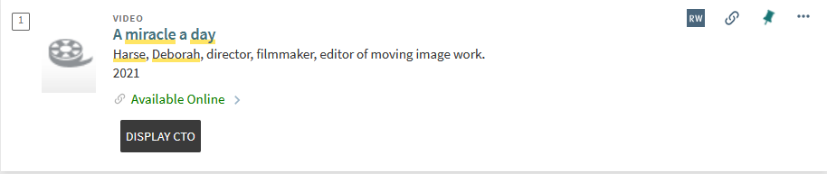
The effects of the inventory network group on the OpenURL
Example Two
After adding “&displayCTO=true” (without the quotes) to the end of the URL we see and click the “Display CTO” link

Slide 82
The effects of the inventory network group on the OpenURL
Example Two
The OpenURL is:
http://exldev-test1.primo.exlibrisgroup.com/view/uresolver/EXLDEV1_INST/openurl?vid=EXLDEV1_INST:Alma&rft.mms_id=99484859900191&u.ignore_date_coverage=true&rfr_id=info:sid/primo.exlibrisgroup.com-alma_local

Slide 83
The effects of the inventory network group on the OpenURL
Example Two
Putting this OpenURL into a browser shows “Full Text Available”.
It works for all institutions for which it is available (Alma University (EXLDEV1_INST) and Open University (EXLDEMO3_INST) and University of Knowledge (EXLDEMO1_INST).

Slide 84
The effects of the inventory network group on the OpenURL
Example Three
Electronic portfolio "Feminist Phenomenology" is available for Alma University (EXLDEV1_INST) and Open University (EXLDEMO3_INST)

Slide 85

The effects of the inventory network group on the OpenURL
Example Three
We search for the portfolio and click “Available Online”

Slide 86

The effects of the inventory network group on the OpenURL
Example Three
After adding “&displayCTO=true” (without the quotes) to the end of the URL we see and click the “Display CTO” link

Slide 87
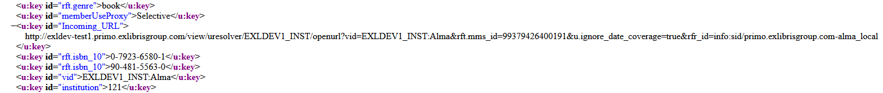
The effects of the inventory network group on the OpenURL
Example Three
The OpenURL is:
http://exldev-test1.primo.exlibrisgroup.com/view/uresolver/EXLDEV1_INST/openurl?vid=EXLDEV1_INST:Alma&rft.mms_id=99379426400191&u.ignore_date_coverage=true&rfr_id=info:sid/primo.exlibrisgroup.com-alma_local

Slide 88
The effects of the inventory network group on the OpenURL
Example Three
Putting this OpenURL into a browser shows “Full Text Available”.
It works for all institutions for which it is available (Alma University (EXLDEV1_INST) and Open University (EXLDEMO3_INST)

Slide 89
The effects of the inventory network group on the OpenURL
Example Three
The OpenURL does not work (correctly) for University of Knowledge (EXLDEMO1_INST) because it is not available for this institution.

Slide 90
The effects of the inventory network group on the OpenURL
Example Four
Electronic portfolio " Companion to Environmental Studies" has no inventory network group, meaning it is available for all institutions: University (EXLDEV1_INST) and Open University (EXLDEMO3_INST) and University of Knowledge (EXLDEMO1_INST)

Slide 91

The effects of the inventory network group on the OpenURL
Example Four
We search for the portfolio and click “Available Online”

Slide 92

The effects of the inventory network group on the OpenURL
Example Four
After adding “&displayCTO=true” (without the quotes) to the end of the URL we see and click the “Display CTO” link

Slide 93

The effects of the inventory network group on the OpenURL
Example Four
The OpenURL is:
http://exldev-test1.primo.exlibrisgroup.com/view/uresolver/EXLDEV1_INST/openurl?vid=EXLDEV1_INST:Alma&rft.mms_id=99485379800191&u.ignore_date_coverage=true&rfr_id=info:sid/primo.exlibrisgroup.com-alma_local

Slide 94
The effects of the inventory network group on the OpenURL
Example Four
Putting this OpenURL into a browser shows “Full Text Available”.
It works for all institutions (Alma University (EXLDEV1_INST) and Open University (EXLDEMO3_INST) and University of Knowledge (EXLDEMO1_INST).

Slide 95
Repository search

Slide 96
Repository search
For electronic collections, these four fields may be searched:
  Collection Available for group
  Collection Available explicitly for group
  Collection available for
  Collection available explicitly for
For electronic portfolios, these four fields may be searched:
  Available for
  Available for group
  Available explicitly for
  Available explicitly for group
Note that some indexes include "explicitly"
Note that some indexes include "group"

Slide 97
Repository search
The indexes which have "explicitly for" means that the group has been assigned to the electronic resource. This will become clear with an example in a moment.
The indexes which end with "for group" search by the name of the inventory network group (which may contain multiple institutions).
The indexes which end with "for" search by the name of the institution which is in the group.
You can read more about these fields at Search Fields , which is part of Searching In Alma .

Slide 98
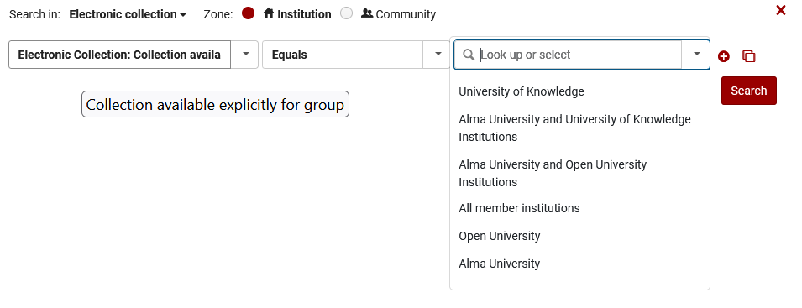
Repository search
This is an Electronic Collection advanced search by "Collection Available Explictly For Group"
These are our Inventory Network Groups

Slide 99
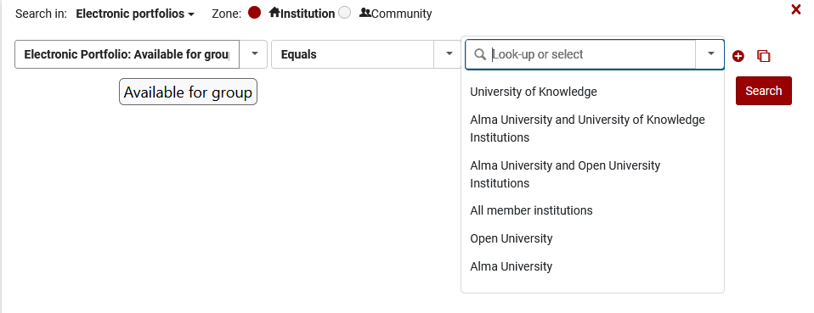
Repository search
This is an Electronic Portfolio advanced search by "Portfolio Available For Group"
These are our Inventory Network Groups

Slide 100
Repository search
In order to see exactly how these indexes work we will look at a specific example and test various searches.
We will concentration on:
  The use of "explicitly for" verses not using "explicitly for"
  The use of "available for" verses "available for group"

Slide 101
Repository search
We will use this example in the Network Zone: where (Electronic Collection Name contains keywords "SpringerLink Books")
SpringerLink Books Education 2018
  Has one group which is "Alma University and University of Knowledge Institutions"
SpringerLink Books Behavioral Science 2012
  Has no groups
SpringerLink Books Lecture Notes In Physics Archive
  Has two groups: "Open University" and another group "University of Knowledge"

Slide 102
Repository search – explicitly for
We search for where (Collection Available for group equals "Alma University and University of Knowledge Institutions" AND Electronic Collection Name contains keywords "springerlink books")
Because there is no "explicitly for" we retrieve both
  Records which have "Available for group" "Alma University and University of Knowledge Institutions"
  Records which have no "Available for group" and therefore are available for all institutions.

Slide 103
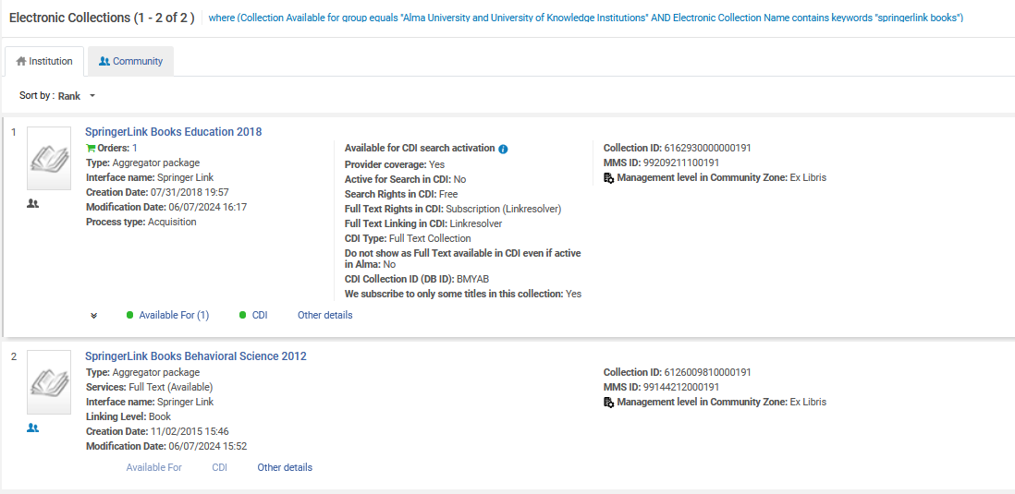
Repository search – explicitly for
No "explicitly for"
Record with "Available for" group
Record without "Available for" group

Slide 104
Repository search – explicitly for
We search for where (Collection Available explicitly for group equals "Alma University and University of Knowledge Institutions" AND Electronic Collection Name contains keywords "springerlink books")
Because there is "explicitly for" we retrieve only
  Records which have "Available for group" "Alma University and University of Knowledge Institutions"
Because there is "explicitly for" we do not retrieve
  Records which have no "Available for group" and therefore are available for all institutions.

Slide 105
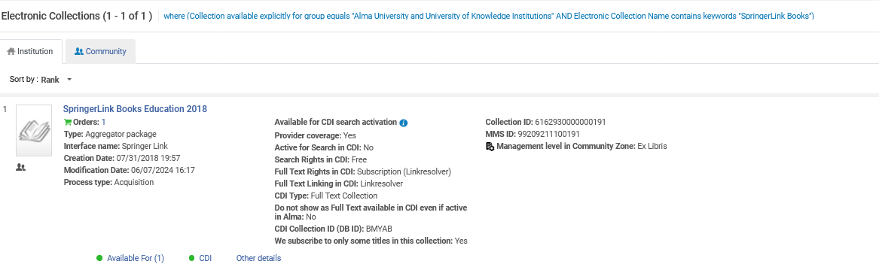
Repository search – explicitly for
Has "explicitly for"
Record with "Available for" group
Record without "Available for" group does not appear in the results

Slide 106


Repository search – "available for" and "available for group"
Search by "Available for" is by the name of the institution
Search by "Available for group" is by the name of the inventory network group

Slide 107
Repository search – "available for" and "available for group"
where (Available For equals "University of Knowledge" AND Electronic Collection Name contains keywords "SpringerLink Books") retrieves records with
  Resource available for 1 group: Alma University and University of Knowledge Institutions
  Resource available for 2 groups: "Open University; University of Knowledge"
  Resource available for no groups (which means "all groups")
where (Collection Available for group equals "University of Knowledge" AND Electronic Collection Name contains keywords "SpringerLink Books") retrieves records with
  Resource available for 2 groups: "Open University; University of Knowledge"
  Resource available for no groups (which means "all groups")

Slide 108

Repository search – "available for" and "available for group"
"Available for"
Record with "Available for" group
Record with 2 "Available for" groups
Record without "Available for" group

Slide 109

Repository search – "available for" and "available for group"
"Available for group"
Record with "Available for" group which is the name of the institution
Record without "Available for" group

Slide 110
Alma Analytics and Inventory Network Groups

Slide 111
Alma Analytics and Inventory Network Groups
Introduction
The Alma Analytics fields which are relevant for Inventory Network Groups are in the E-Inventory subject area.
They exist in the following two folders:
  Portfolio
  Portfolio Details for Consortia Members > -- Portfolio

Slide 112
Alma Analytics and Inventory Network Groups
Introduction
The Fields are as follows per folder:
  Portfolio
    Available For Group Members
    Available For Group
    Available For Resource Type
  Portfolio Details for Consortia Members > -- Portfolio
    Available For Group Members
    Available For Group
    Available For Resource Type
    Available For My Institution
These fields are relevant when using
Inventory Network Groups by Library or Campus within a standalone institution
The Network Zone institution of a consortia
These fields are relevant when using Inventory Network Groups within a member institution of a network zone consortia

Slide 113
Alma Analytics and Inventory Network Groups
Introduction
In order to understand these fields, we will look at two reports:
  A report created in and viewed in the network zone showing all Electronic Collections that have an inventory network group
  A report created in a member institution showing all Electronic Collections that are available for that member institution

Slide 114
Alma Analytics and Inventory Network Groups
Configuration
In order for a Member Institution to see the data from the Network Zone there needs to be a relevant configuration in both
  The Member Institution
  The Network Zone institution

Slide 115
Alma Analytics and Inventory Network Groups
Configuration
Step One
In the network zone navigate to "Configuration > Analytics > Analytics Networks Settings" and set the parameter "analytics_network_inventory_available_for_members" to true.
Step Two
In the network zone after setting "analytics_network_inventory_available_for_members" to true select "Manage in Network" from the row actions and then click "Save and Distribute".

Slide 116
Alma Analytics and Inventory Network Groups
Configuration
Step Three
After clicking "Save and Distribute" choose "Override member institution customization".
The only value that this changes in the member institutions is that it allows the members to be able to define that they will be able to see data from the network zone in E-Inventory Alma Analytics reports.
It does not change anything else.

Slide 117

Alma Analytics and Inventory Network Groups
Configuration
In the Network Zone
"analytics_network_inventory_available_for_members" is set to true
Managed in the Network

Slide 118

Alma Analytics and Inventory Network Groups
Configuration
In the member institution navigate to "Configuration > Analytics > Analytics Member Settings" and set the parameter "analytics_network_inventory_available_for_my_institution" to true.
In the Member Institution
"analytics_network_inventory_available_for_my_institution" is set to true

Slide 119
Alma Analytics and Inventory Network Groups
Report in Network
In the network zone we have a report created in the E-Inventory subject area called "Electronic Collections with Available For Groups in Ex Libris University Consortium"
It displays the following fields (before the period is the folder name and after the period is the field name):
  "Portfolio"."Available For Group"
  "Portfolio"."Available For Group Members"
  "Portfolio"."Available For Resource Type"
  "Electronic Collection"."Electronic Collection Public Name"

Slide 120
Alma Analytics and Inventory Network Groups
Report in Network
It filters as follows (before the period is the folder name and after the period is the field name):
  "Portfolio"."Available For Group" IS NOT NULL
  "Institution"."Institution Name" = 'Ex Libris University Consortium'
  "Electronic Collection"."Electronic Collection Lifecycle" = 'In Repository'
  "Portfolio"."Lifecycle"= 'In Repository'

Slide 121
Alma Analytics and Inventory Network Groups
Report in Network
The following filter is necessary because for our purposes we want only Electronic Collections which have an "Available For" group.
It is coming from the portfolio folder, as all portfolios of an Electronic Collection inherit the Available For Group from the Electronic Collection.
  "Portfolio"."Available For Group" IS NOT NULL

Slide 122
Alma Analytics and Inventory Network Groups
Report in Network
The following filter is necessary because for our purposes we want only Electronic Collections which are in the Network Zone.
From the Network Zone analytics, it is possible also to retrieve entities in the members institutions, and now we do not want to do this.
  "Institution"."Institution Name" = 'Ex Libris University Consortium'

Slide 123
Alma Analytics and Inventory Network Groups
Report in Network
The following filter is necessary because we want only existing (not deleted) Electronic Collections.
In Alma Analytics it is also possible to retrieve deleted entities, and now we do not want to do this.
  "Electronic Collection"."Electronic Collection Lifecycle" = 'In Repository'

Slide 124
Alma Analytics and Inventory Network Groups
Report in Network
The following filter is necessary because we want only existing (not deleted) Electronic Portfolios (Even though we already filtered by Electronic Collection is In Repository, it is recommended to also filter by Electronic Portfolio as well.
In Alma Analytics it is also possible to retrieve deleted entities, and now we do not want to do this.
  "Portfolio"."Lifecycle"= 'In Repository'

Slide 125

Alma Analytics and Inventory Network Groups
Report in Network
Here is the criteria tab

Slide 126

Alma Analytics and Inventory Network Groups
Report in Network
Here are (the beginning of the report with) the results
Let's take a look in Alma at the first result which states that Electronic Collection "ACC Elsevier" is Available For groups "Alma University" and "Open University".

Slide 127

Alma Analytics and Inventory Network Groups
Report in Network
Here is the Electronic Collection in Alma.
As stated in Analytics the Electronic Collection "ACC Elsevier" is Available For groups "Alma University" and "Open University".

Slide 128
Alma Analytics and Inventory Network Groups
Report in Member
In the member institution Alma University, we have a report created in the E-Inventory subject area called "Electronic Collections with Available For Groups in Ex Libris University Consortium and available for my institution"
It displays the following fields from the "Portfolio Details for Consortia Members" folder (before the period is the folder name and after the period is the field name):
  "-- Electronic Collection"."Electronic Collection Public Name"
  "-- Portfolio"."Available For Group"
  "-- Portfolio"."Available For Group Members"
  "-- Portfolio"."Available For My Institution"

Slide 129
Alma Analytics and Inventory Network Groups
Report in Member
It filters as follows using the following fields from the "Portfolio Details for Consortia Members" folder (before the period is the folder name and after the period is the field name):
  "-- Electronic Collection"."Electronic Collection Lifecycle" = 'In Repository'
  "-- Portfolio"."Lifecycle" = 'In Repository'
  "-- Portfolio"."Available For My Institution"= 'Yes'
  "-- Portfolio"."Available For Group" IS NOT NULL

Slide 130
Alma Analytics and Inventory Network Groups
Report in Member
The following filter is necessary because for our purposes we want only Electronic Collections in the4 Network Zone which have an "Available For" group. (Electronic Collections in the network Zone with no Available For group are by default available for all member institutions, but for our purposes we want only those Electronic Collections which do have an "Available For" group).
It is coming from the portfolio folder, as all portfolios of an Electronic Collection inherit the Available For Group from the Electronic Collection.
  "-- Portfolio"."Available For Group" IS NOT NULL

Slide 131
Alma Analytics and Inventory Network Groups
Report in Member
The following filter is necessary because for our purposes we want only Electronic Collections which are available for my institution (Alma University, which is the institution from where the report is being run).
  "-- Portfolio"."Available For My Institution"= 'Yes'

Slide 132
Alma Analytics and Inventory Network Groups
Report in Member
The following filter is necessary because we want only existing (not deleted) Electronic Collections.
In Alma Analytics it is also possible to retrieve deleted entities, and now we do not want to do this.
  "-- Electronic Collection"."Electronic Collection Lifecycle" = 'In Repository'

Slide 133
Alma Analytics and Inventory Network Groups
Report in Member
The following filter is necessary because we want only existing (not deleted) Electronic Portfolios. (Even though we already filtered by Electronic Collection is In Repository, it is recommended to also filter by Electronic Portfolio as well.
In Alma Analytics it is also possible to retrieve deleted entities, and now we do not want to do this.
  "-- Portfolio"."Lifecycle" = 'In Repository'

Slide 134

Alma Analytics and Inventory Network Groups
Report in Member
Here is the criteria tab

Slide 135

Alma Analytics and Inventory Network Groups
Report in Member
Here are (the beginning of the report with) the results
Let's take a look in Alma at the second result which states that Electronic Collection "AdisOnline" is Available For group "Alma University"

Slide 136

Alma Analytics and Inventory Network Groups
Report in Member
Here is the Electronic Collection in Alma.
Searching Member Institution using the "Institution" tab and search scope "Combined results"
As stated in Analytics the Electronic Collection "AdisOnline" is Available For group "Alma University" (which is "My Institution")

Slide 137
Inventory Network Groups for libraries and campuses

Slide 138
Inventory Network Groups for libraries and campuses
Until now we have seen examples of inventory network groups for an entire institution.
As of Nov. 2024 it is possible to allocate electronic resources to specific libraries or campuses of a member institution.

Slide 139

Inventory Network Groups for libraries and campuses
Upon setting the customer parameter nz_multi_campus_members to true in the Network Zone institution, Inventory network groups in the network zone can include libraries and campuses from within member institutions.

Slide 140

Inventory Network Groups for libraries and campuses
We will now create an inventory network group for the “Social Work Library” of the “University of Knowledge”.
From the Network Zone institution, we access the Inventory Network Groups at “Configuration > Resources > General > Inventory Network Groups” and click “Add group”

Slide 141

Inventory Network Groups for libraries and campuses
The name and description of the group is “University of Knowledge - Social Work Library”

Slide 142

Inventory Network Groups for libraries and campuses
Now we will add the Consortia Member Library

Slide 143

Inventory Network Groups for libraries and campuses
The Consortia Member Library has been added, and we will save

Slide 144

Inventory Network Groups for libraries and campuses
The new Inventory Network Group appears with the list of other groups

Slide 145

Inventory Network Groups for libraries and campuses
From the Network Zone we will activate electronic collection “Taiwan Epochal Democracy Magazines” from the Community Zone

Slide 146

Inventory Network Groups for libraries and campuses
In the Network Zone the electronic collection “Taiwan Epochal Democracy Magazines” has been activated from the Community Zone and we will edit the collection

Slide 147

Inventory Network Groups for libraries and campuses
We will add a group settings

Slide 148

Inventory Network Groups for libraries and campuses
We will choose “University of Knowledge - Social Work Library” which is the group we made a few moments ago for a specific library in a specific member institution.

Slide 149

Inventory Network Groups for libraries and campuses
A repository search in the Network Zone institution “Institution” tab shows the resource is “Available For” “University of Knowledge - Social Work Library”

Slide 150

Inventory Network Groups for libraries and campuses
From the University of Knowledge, it can also be seen that it is “Available For” the Social Work Library.

Slide 151

Inventory Network Groups for libraries and campuses
If we search Primo University of Knowledge, we find the record

Slide 152

Inventory Network Groups for libraries and campuses
If we search Primo University of Knowledge, in search profile slot “Social Work Library”, we find the record

Slide 153

Inventory Network Groups for libraries and campuses
But … If we search Primo University of Knowledge, in search profile slot “Biology Library”, we correctly do not find the record

Slide 154

Inventory Network Groups for libraries and campuses
We also correctly do not find the record in Primo of Alma University or Open University. Here is Open University

Slide 155

Inventory Network Groups for libraries and campuses
Here is Alma University, where we also correctly do not find the record.

Slide 156
Inventory Network Groups for libraries and campuses
Another electronic collection activated from the Network Zone with Inventory Network Group “University of Knowledge - Social Work Library” is “Bloomsbury Collections: I.B. Tauris Women, Sex & Gender in the Middle East”.
It behaves the same way.

Slide 157

Inventory Network Groups for libraries and campuses
Portfolio title “Gender, modernity and liberty : Middle Eastern and Western women's writings, a critical sourcebook” is part of electronic collection “Bloomsbury Collections: I.B. Tauris Women, Sex & Gender in the Middle East”.

Slide 158

Inventory Network Groups for libraries and campuses
If we search the University of Knowledge Social Work Library in Primo VE we find it.

Slide 159

Inventory Network Groups for libraries and campuses
If we search the University of Knowledge Biology Library in Primo VE we do not find it.

Slide 160

Inventory Network Groups for libraries and campuses
If we search the Open University in Primo VE we do not find it.

